Slide 1
Week 02
Instructor’s AWS Public IP: 3.211.216.90

Slide 2
On-campus peeps
For department owned rooms
Russ: 152C, 339, 346, 355
OH: 320
Firefox has private browsing mode enabled
This causes Webex to not authenticate
Use Chrome

Slide 3
Extras
https://education.github.com/pack
Free student access to a certain set of resources for a set of time or usage requirements
https://www.humblebundle.com/books/unix-linux-books
https://www.humblebundle.com/books/machine-learning-bookshelf-no-starch-press-books
Humble Bundle is a really sweet site (mostly known by gamers) but they also do book bundles!
I’ll be tossing out these links now and then - it can be cool to get a good price on a book(s) to deep dive into new topics!

Slide 4
Announcements:
Pre-Req Quiz due Thursday, 9/2
CEG2350 OS Concepts & Usage - Assessment of Course Preparedness - Updated Su 2016
Not for a grade, just a department required status check
We are using it to meet attendance requirements
Lab 01 due Saturday 9/4 at 11:59 PM
10% off per day late until 9/7
Do NOT save your questions for Saturday - the Tas and I are available through the week on Discord, office hours, or via email.

Slide 5
Questions:
Where are WSL 2 files in the Windows File Explorer?
In WSL2 terminal: `explorer.exe .`
Where the dot tells explorer to open in this folder right here
Do not mess around with WSL2 from Windows tools
Can cause odd permissions errors / corruption

Slide 6
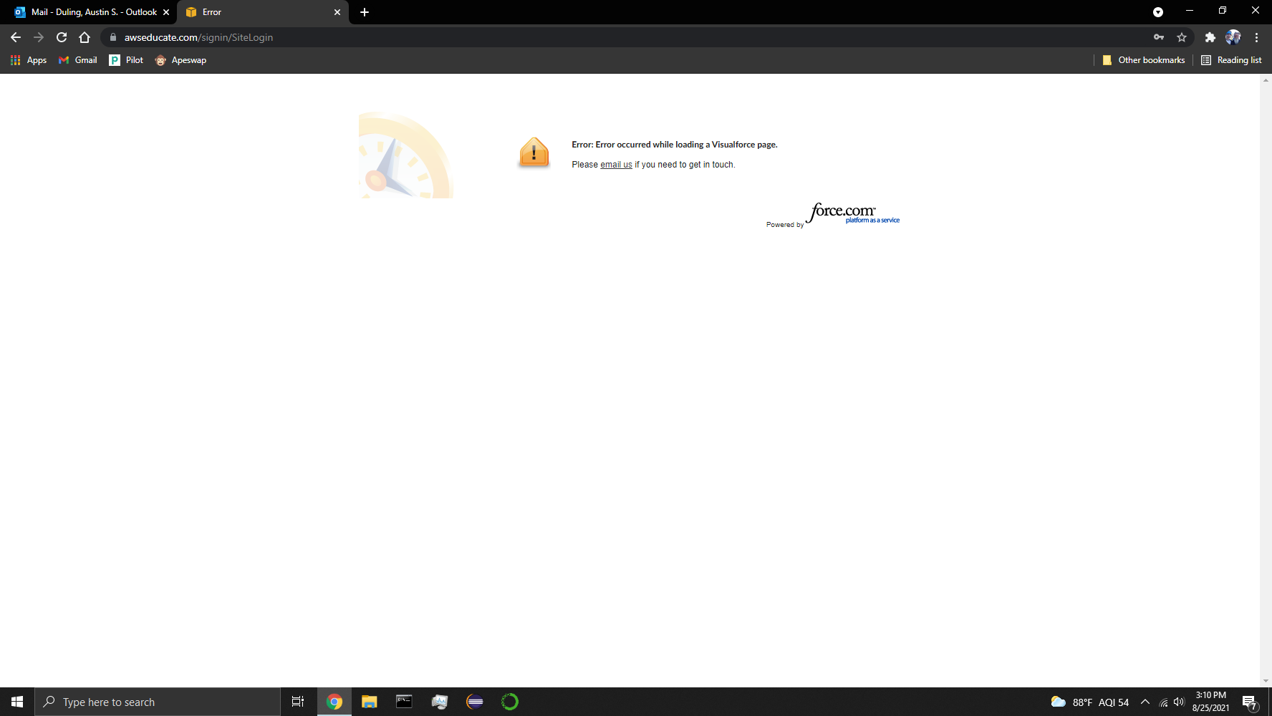
Lab Setup
https://www.awseducate.com/student/s/
Mac users - don’t use Safari (not playing well with Webex or AWS)
Chrome seems happiest right now with all the things

Slide 7
SSH Key Points

Slide 8
Intro to SSH
SSH = Secure SHell
Command interface / protocol for secure remote connections
Tunnel between you and remote system
Can use keys for authentication
The AWS instance will ONLY allow use of key based authentication
Password authenticated ssh is a thing
Keys files provide more security

Slide 9
Key permissions
Private keys must be private to you
$ chmod 600 my_key_filename
chmod = change file mode. Our primary use will be changing permissions
600 = 6 0 0
6 = the username in charge of this file can read (4) and write (2)
0 = no permissions for group members
0 = no permssions for others who access the system
Our private key should NOT be something anyone else but yourself can have access to

Slide 10
The ssh command
$ ssh -i my_key_file_name ubuntu@AWS_IP
ssh is a command that will attempt to start a secure shell using the details provided after ‘ssh’ is typed
-i is a flag. It stand for identity file. After the -i flag, we put the path to our private key
my_key_filename is your private key. You can include a path (or folder structure) to get to your key
You might need to copy the key to a more convenient spot
ubuntu is the default username we need to use to access the AWS instance. Ubuntu is the only user that exists over there
AWS_IP is the PUBLIC IP address to your AWS instance

Slide 11


Slide 12
Intro to Git
Version management software
Savior of programmers / developers
GitHub is a server / host of repositories
Git is a program / command for version management
Notes:
https://docs.github.com/en/github/authenticating-to-github/generating-a-new-ssh-key-and-adding-it-to-the-ssh-agent

Slide 13
GitHub & git commands for Lab 01
Your repo has been created for you. Click link in Pilot -> Content -> Labs to set up
$ git clone URL
Copies the repository
Repository is set up to use git
Also set up to use authentication method selected.
Queue talking about SSH key authentication

Slide 14
SSH Keys
Keys come in pairs – public and private
Public key - lock on remote system
Private key - opens the lock on remote system
Private keys are for you on your local system
Protect the keys!
Usually stored in a hidden folder called .ssh
Once you create your AWS instance, you’ll need to create a key pair for GitHub authentication
Notes:
https://www.digitalocean.com/community/tutorials/ssh-essentials-working-with-ssh-servers-clients-and-keys

Slide 15
Setting up GitHub
Create a key pair
Do this for each system you want to hook to GitHub
Find the public key of that pair
look at your output from making your key
Boom. Done.
“git”, the program, knows how to find the private key (if you left the defaults alone) and will check with GitHub to use the public key you gave it
This is because git is using the SSH protocol and agent - there are default search flows set by the agent

Slide 16
Git config commands
$ git config --global user.name "John Doe"
$ git config --global user.email johndoe@example.com

Slide 17
Basic git commands
git clone URL
uses URL & sets up connection back to GitHub
git add files/folders
add files to be tracked (if they are new)
git commit
Commits are like checkpoints. You write a note of what changes happened. Only the changes of files are captured in a commit
git push
pushes commits (think record of latest changes) to GitHub

Slide 18
PRE REQ QUIZ
TAKE IT
By tonight at 11:59 PM
So we have documentation you are here!
Pilot page -> Assessment -> Quizzes & Exams ->
CEG2350 OS Concepts & Usage - Assessment of Course Preparedness - Updated Su 2016
Not for a grade. Don’t be scared.

Slide 19
NO LAB MONDAY 9/6
Tis a holiday.
Sleep in.
Eat something grilled.
If you want.
I’m just words on a slide.

Slide 20
Pick Up Here
https://media-exp1.licdn.com/dms/image/C4D22AQGnwNnbnE2Ytg/feedshare-shrink_800/0/1630240011243?e=1633564800&v=beta&t=sYvEf66Uyt8tH-_HeeRd9R5kM-qSDek2B1RHB24-fAQ
Shout out to types of immersive learning:
Comics: https://www.commitstrip.com/en/
Subscribe to subreddits
Get in tune with some blog posts (from trusted sources)
Towardsdatascience (email required)
Digitalocean
Check out related links I post with content

Slide 21
OS structure, Directories, and Files

Slide 22
Structure of OS & Directories
Think of a tree
Windows – tree base = C:\
Linux / Mac – tree base = /
Branching from the root is the organization of the operating system
C:\Windows is most of OS, other directories contain applications, user settings, etc.
Linux branches its OS – processes have logs, which are in /var/log, whereas applications are installed to /lib, for example
Notes:
https://www.linux.com/training-tutorials/linux-directory-structure-home-and-root-folders/

Slide 23
All my x’s for OSes
x## represents the capabilities of the CPU
How many instructions can it handle
x32 = x86 - capable of handling 32 bit instructions
x86 were the end numbers of the chipset that supported 32 bit instructions
x64 - capable of handling 64 bit instructions
We’ll circle back to this when we hit up kernels & OSes more in depth
These architectures are NOT dead
Notes:
https://www.seeedstudio.com/blog/2020/02/24/what-is-x86-architecture-and-its-difference-between-x64/

Slide 24
Importance of Names & Extensions
Some programs (especially Windows) rely on extension to assign default programs that open the file type
Enable file type viewing in Windows
In Linux, extensions are important for consistency & universal understanding
Naming conventions
Avoid spaces, strange special characters, etc.
My School Folder vs “My School Folder”

Slide 25
Directories / Folders
Keeps the association of name(s) and location of content(s)
Names of files and corresponding I-nodes
Every directory has a parent directory it belongs to
The top level directory is parent of itself
In a directory, if you run "ls –lah", you'll see two listings with dots
"." is a reference to itself
".." is a reference to it's parent

Slide 26
Absolute vs Relative Path
Relative is relative to where you are
Can still be a path, though
class-examples/my_file.txt
file_open(my_file);
Absolute is the full directory path, no shortcuts
/home/ubuntu/class-examples/my_file.txt
file_open(C:\Users\kduncan\Documents\data\my_file.txt)

Slide 27
Linux Directories & Permissions

Slide 28
Creating Directories & Files
Commands for folders:
mkdir, rmdir, ls
Commands for files:
cat, vim / nano, touch, rm, head / tail, less / more
Commands to move / change structure
mv, cp
Notes:
This assumes you know how in Windows, but maybe not in a command line

Slide 29
* Vs .
* - a wildcard pattern matcher
/etc/*-release will match anything that ends in “-release” in /etc/
. – think “this directory right here”
“git add .”– add anything in this directory
.. – think “the directory before”

Slide 30
File Permissions: Linux
Run "ls –lah" in a directory with a file in it
There are four "chunks"
Starts with "d" - is a directory
Starts with "-" - is a file
Starts with something else? Google it.
Next three spots define "user" permission
Each spot defines if read [r], write [w], and execute [x] are set
Next three define "group" permissions
Final three define "other" permissions
Next, it tells you who owns the file, and to which group it belongs

Slide 31
File Permissions: Linux
chmod followed by a filename
Can use numbers to set permissions
Can use a more verbose command –
u (user), g (group), o (other)
followed by (+) to add a privilege or (-) to remove a privilege
followed by [r] for read, [w] for write, or [x] for execute
So chmod go-rw would remove read and write privileges for group and other
Notes:
https://www.guru99.com/file-permissions.html

Slide 32
$ chmod 600 key_name.pem
Think of the numerics as 6 0 0
6 = user permissions to read & write
0 = group permissions to get nothing (no rwx)
0 = other permissions to get nothing (no rwx)
0 = no one in this tier gets anything (no rwx)
1 = execute
2 = write
3 = write + execute
4 = read
5 = read + execute
6 = read + write
7 = read + write + execute
Notes:
https://chmodcommand.com/

